Slide 1
Software Maintenance and Process Scheduling
In this session we look at some fundamental concepts behind software maintenance which highlight its importance as a major component of software development. We then move on to process control through the use of task scheduling and its modelling.

Slide 2
Session Aims
The main aim of this session is to outline the maintenance process in software engineering, to explain its various parts, to provide a scientific framework for system evolution, and to present a form of measurement of the maintenance effort. To end, two methods used for project activity scheduling will be explained.
Introduce the ideas behind system maintenance in terms of overall system development
Lehman’s Laws of system evolution
Maintenance measurement
Activity scheduling methods

Slide 3
Session Contents
Maintenance and system evolution
Maintenance metrics
System Complexity metrics
Scheduling models

Slide 4
Common Views on Maintenance
Some basic misconceptions of maintenance:
Can be considered after solution delivery
Is something secondary to (and not as important as) development
Can be handled by less-competent developers
Not that important to clients
Not that costly
Might never be needed anyway

Slide 5
The Truth Be Told…
The truth about maintenance in the modern system development process:
Must be a driving factor in the way a solution is built
Is actually a mini development cycle in its own right
The people who build the solution should be the ones who maintain it
Is often the clinching issue of many software development contracts
Should not be costly – however, if neglected can be even more costly than the solution itself
Is critical for the continued usefulness, and survival, of the system

Slide 6
Maintenance in Development
All values in chart are approximated from various sources and rounded.

Slide 7
Reasons for High Maintenance Costs
Reputation as being “second class development” amongst software developers
The widespread presence of legacy systems
Innovation brings new errors with it
Gradual degradation of long-standing and often-maintained systems (this will be better explained in the part dealing with Lehman’s Laws)
Inaccurate and un-matching documentation

Slide 8
Highlighting the Importance of Maintenance
Barry Boehm proposes the following stances (with some personal adaptation):
Link software maintenance rewards to organisational performance
Make software members of operational teams take turns at maintenance – create no distinction of roles
Allow adequate budget and a good degree of independence within teams handling maintenance
Involve maintenance staff early in the software process and during all stages of development.

Slide 9
Types of Maintenance
Perfective
Bringing solution “up-to-scratch” with any minor changes in requirements as well as improving its external quality attributes
Adaptive
Changes brought about by technology and/or working environment changes
Corrective
Carrying out repairs in any development phase of the system
Preventive
Making the solution easier to maintain and understand

Slide 10
Maintenance Categories
All values in chart are approximated from various surveys and rounded.

Slide 11
A Maintenance Process Example
A maintenance process which uses the different types of maintenance is the following:
Change
request
Impact analysis
Plan system release
Implement change
System release
Perfective maintenance
Adaptive maintenance
Corrective maintenance
Taken from Ian Sommerville

Slide 12
Regression Testing
When parts of a system are changed, one must ensure that the unchanged parts work as they did before. This is called regression testing, and is made up of the following steps:
Prepare a general purpose set of test cases (TCs) for the existing system.
Run the TCs on the existing version and save the results.
Make program modifications.
Now run the same TCs on the modified and save the results.
Compare both sets of results (i.e. from existing and modified).
THE RESULTS SHOULD BE IDENTICAL.

Slide 13

Lehman’s Laws of System Evolution
Meir Manny Lehman (while Professor at Imperial College, University of London), together with colleagues, proposed a set of distinct behavioural patterns governing software system evolution. These patterns came to be known as Lehman’s Laws.
He firstly classified programs into three types:
S-type systems are programs that can be specified formally.
P-type systems cannot be specified. They require an iterative process to find a working solution.
E-type programs are embedded in the real world and become part of it. This leads to a feedback system where the program and its environment evolve together

Slide 14
Lehman’s Laws of System Evolution
Lehman goes on to formulate 8 laws of software evolution for E-Type systems. They describe a balance between forces driving new developments and forces that slow down progress. These are the most quoted laws:
Continuing change
Software must continually change and adapt to its environment. Otherwise it will degrade.
Increasing complexity
As a system evolves, it’s complexity will increase, unless work is specifically done to control it.
Declining Quality
The quality of a program will appear to deteriorate over time unless it is rigorously maintained.
Feedback System
Evolution processes need to be feedback based in order to achieve significant improvement over time.
Conservation of familiarity
As a system grows, anyone associated with the system must maintain master of its content and behaviour to achieve satisfactory evolution. Excessive growth diminishes that mastery. Hence the average incremental growth remains invariant as a system evolves.

Slide 15
Maintenance Cost
Technical factors effecting maintenance cost
Module independence (maintainability)
Programming language (understandability)
Programming style (understandability)
Documentation (understandability)
Configuration management (configurability)
Non-technical factors effecting maintenance cost
Application domain familiarity (i.e. clear comprehension)
Staff stability (i.e. the builders are the maintainers)
Program age (i.e. structure degradation)
External environment (i.e. real-word dependence)

Slide 16
Maintenance Cost Estimation
Annual Change Traffic (ACT) is the fraction (%) of a software product’s source instructions which undergo change during a (typical) year either through addition or modification (taken from Ian Sommerville)
Annual Maintenance Effort (AME) is calculated as follows:
AME = ACT x PM
where PM represents the estimated or actual development effort in person (or programmer)-months for the whole system

Slide 17
Maintenance Effort Estimation Example
Let us assume that a 90pm were required to develop a system. Furthermore, it is estimated that the annual change traffic (ACT) is 15% (i.e. approx. 15% of code will change in the course of a year)
Therefore, the annual maintenance effort (AME):
AME = 0.15 * 90pm = 13.5pm
A possible problem to this approach (Sommerville):
What would the ACT value for new systems be?

Slide 18
Modularity
Definition: “One of a set of separate parts which, when combined, form a complete whole” (Cambridge on-line dictionary)
In many classifications, this is a recurring factor influencing system maintenance.
Modularity influences system complexity which directly effects system maintainability
The metrics used to measure system complexity are:
Coupling (defined as the 5 levels of coupling)
Cohesion (defined as the 7 levels of cohesion)

Slide 19
Levels of Coupling
Content Coupling (Highest form of coupling)
Occurs when one modifies or depends on data within another module. E.g. accessing a property of a class directly.
Common Coupling
Occurs when two modules share the same global data. Changing it affects all modules using it.
Control Coupling
One module controls the behaviour of another.
Stamp Coupling
Modules share whole data structures when they only use parts of them
Data Coupling (Lowest form of coupling)
Modules share only required data

Slide 20
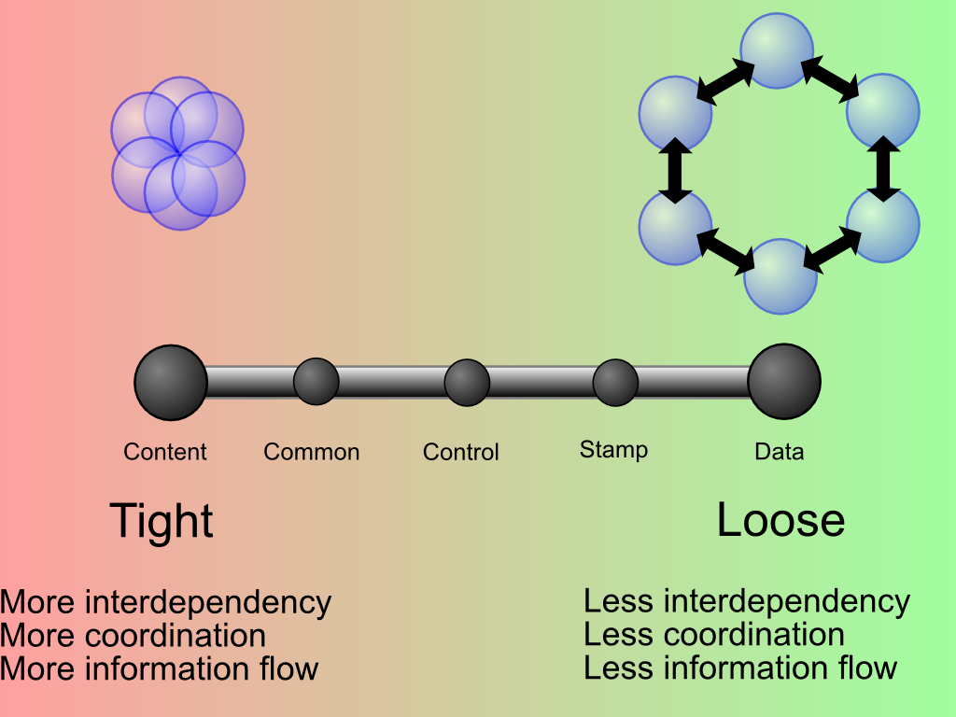
Levels of Coupling
http://upload.wikimedia.org/wikipedia/commons/9/9c/Coupling_sketches_cropped_1.svg

Slide 21
Levels of Cohesion
Coincidental Cohesion (Lowest form of cohesion)
Methods groups arbitrarily.
Logical Cohesion
Methods grouped because they are categorised as doing the same class of tasks.
Temporal Cohesion
Methods grouped by when they are accessed (e.g. exception handlers)
Procedural Cohesion
Methods grouped because they form part of a sequence of execution
Communicational Cohesion
Methods are grouped because they operate on the same data
Sequential Cohesion
Methods are grouped because the output of one is used as input to another
Functional Cohesion (Highest form of cohesion)
Methods are grouped because they all contribute to a single well-defined task

Slide 22
Project Scheduling
Definition: “A list of planned activities or things to be done showing the times or dates when they are intended to happen or be done” (Cambridge on-line dictionary)
A software project is made up of activities, and these must happen according to plan – i.e. scheduled.
Schedulable components:
Activities
Resources (including the human variety)
Time (durations and deadlines)
Products (intermediate and final)

Slide 23
Activity On Arrow Diagrams
We need to be able to clearly model activities to be able to schedule them. One approach is to use an Activity On Arrow (AOA) style diagram.
A prime example of such (AOA) diagrams is the Project Evaluation and Review Technique (or PERT) chart.
Diagram components (symbols)
Nodes (drawn as circles)
Links (drawn as directed arcs)
Symbol meanings
Nodes: Start/Stop events (points)
Links: Activities

Slide 24
AOA Chart Construction Rules
Must contain only one start and one end node
A link has duration (optionally shown)
A node has no duration (simply start/stop point)
Time flows from left to right
Nodes are numbered sequentially
Loops are not allowed (by concept)
“Dangles” are not allowed (except in the case of the one and only end node)

Slide 25
AOA Chart Example (1/3)
E
1
A
2
C
3
F
5
H
6
D
G
B
4
Explanation:
The above project (or part of) consists of eight activities (“A”~“H”). The duration of each activity is not indicated. The project starts at node one and ends at node six. The derived duration of activity “A” is the time difference between node two and node one; the derived duration of activity “B” is the time difference between node four and node one; and so on.

Slide 26
AOA Chart Example (2/3)
Read
sources
Type personal
notes
1
4
. . .
3
. . .
Start word
processor
Write some
rev. questions
2
5
Explanation:
There are four activities in all. A student reads from various sources and starts a word-processor to then type in some personal notes and furthermore, manually writes some questions on paper to remember to ask the lecturer. IN PRACTICE reading and writing questions can proceed separately from starting the word processor to type in some personal notes. THEREFORE…

Slide 27
AOA Chart Example (3/3)
Read
sources
Write some
rev. questions
1
3
5
. . .
. . .
Start word
processor
Type personal
notes
2
3a
4
Dummy link
Please note, that a dummy link has zero duration time and uses absolutely no resources.

Slide 28
PERT Chart Nodes
Earliest
date
PERT Chart (milestone) node
Latest
date
Activity ID and duration
PERT Chart activity

Slide 29
PERT Chart Example (1/2)
Let us take the table below, representing various
activities in a hypothetical project, as an example.
Activity | Duration (units) | Dependencies
Task 1 | 10
Task 2 | 12
Task 3 | 17 | Task 2
Task 4 | 25 | Tasks 1 & 3
Task 5 | 35 | Tasks 1 & 3
Task 6 | 18 | Tasks 4 & 5
A PERT chart model of this sequence of activities
is shown on the next slide.

Slide 30
PERT Chart Example (2/2)
10
54
82
Task 1 (10)
29
64
82
0
0
Task 4 (25)
Task 6 (18)
Task 2 (12)
12
Task 3 (17)
29
Task 5 (35)
64
12
29
64
The “critical path” is the one that contains activities that would cause
project delay on the whole had they to be delayed themselves.
In this example: Tasks 2, 3, 5, and 6.

Slide 31
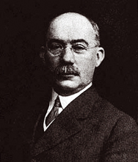
Gantt Chart Example
Gantt charts are a form of bar chart published by
Henry Laurence Gantt (an American mechanical
engineer) in 1910.
Activity
1
Critical
path
2
3
4
5
6
Time
(units)
0
10
20
30
40
50
60
70
80
90

Slide 32
Summary
An introduction to software system maintenance
Types of maintenance
Software evolution through two of Lehman’s Laws
Maintenance measurement and regression testing
Coupling and cohesion as complexity/maintainability metrics
An introduction to scheduling
Scheduling through PERT and Gantt charts

Slide 33

Barry W. Boehm
Dr. Barry Boehm served within the U.S. Department of Defense (DoD) from 1989 to 1992 as director of the DARPA Information Science and Technology Office and as director of the DDR&E Software and Computer Technology Office. He worked at TRW from 1973 to 1989, culminating as chief scientist of the Defense Systems Group, and at the Rand Corporation from 1959 to 1973, culminating as head of the Information Sciences Department. He entered the software field at General Dynamics in 1955.
His current research interests involve recasting software engineering into a value-based framework, including processes, methods, and tools for value-based software definition, architecting, development, validation, and evolution. His contributions to the field include the Constructive Cost Model (COCOMO), the Spiral Model of the software process, and the Theory W (win-win) approach to software management and requirements determination. He has received the ACM Distinguished Research Award in Software Engineering and the IEEE Harlan Mills Award, and an honorary ScD in Computer Science from the University of Massachusetts. He is a Fellow of the primary professional societies in computing (ACM), aerospace (AIAA), electronics (IEEE), and systems engineering (INCOSE), and a member of the U.S. National Academy of Engineering.
Back to originating slide

